Slide 1
Kinematic Equations

Slide 2

In this Smart Lesson you will learn to:
Recall the kinematic equations.
Solve problems using the kinematic equations.

Slide 3

In this lesson, we will be learning about kinematics in the context of weapons of war in medieval times.
The medieval period was a violent period of history, and many different weapons were used during this time.
The simple bow and arrow was one of the most effective killing devices as it could be fired from distance on the battlefield or from the safety of a castle.

Slide 4
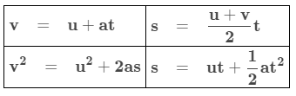
What are the kinematic equations?
When you study Physics, it doesn't take long to find more complex situations where the velocity and acceleration definitions don't work by themselves. This means we need some more equations, the kinematic equations. Here they are in a nice table:
In the above equations, "s" can also be written as "d" (displacement). Also "v" may be written "v_{f​}" (final velocity) and "u" may be written "v_{i}​" (initial velocity).
These equations can only be used when the object you're looking at has a constant acceleration. You will be given enough data to use at least one equation; if you have a choice, use the one that requires the least algebra to solve.

Slide 5
When we record the motion of an object, we are usually interested in these five quantities of motion:
Initial speed (u or v_{i​})
Displacement (s or d)
Acceleration (a)
Final speed (v or v_{f}​)
Time (t)
The great thing about these quantities is that if we know three values we can work out the values of either of the other two.

Slide 6
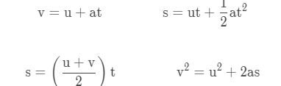
To work out unknown values we use equations called the kinematic equations.
For any given problem you will need to:
List known values from v, u, a, s, and t.
Identify the unknown value.
Select an appropriate kinematic equation.
Solve the problem and answer the question.

Slide 7

Let's look at an example.
The first thing you need to do is list known and unknown values from v, u, a, s and t.
Have a look at the question below. Read and interpret the question carefully to match up the three known values to the list above.
Which quantity is mentioned in the question, but not given as a value?
"An arrow being pushed by a bow string accelerates at 160 ms⁻² over 0.11 s. The initial speed of the arrow is 0 ms⁻¹ How far does the arrow travel during this time?"

Slide 8
First write down the known values:
"An arrow being pushed by a bow string accelerates at 160 ms⁻² over 0.11 s. The initial speed of the arrow is 0 ms⁻¹. How far does the arrow travel during this time?"
The known values in this question are:
Acceleration (a) | = | 160 ms⁻²
Time (t) | = | 0.11 s
Initial speed (u) | = | 0 ms⁻¹
The unknown value is distance (s).

Slide 9
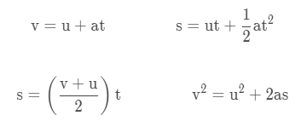
The next thing you need to do is find a kinematic equation that contains these four values.
"An arrow being pushed by a bow string accelerates at 160 ms⁻² over 0.11 s. The initial speed of the arrow is 0 ms⁻¹ How far does the arrow travel during this time?"
You have values for a, t and u and need to find s.
Which equation below contains all four values mentioned in the question above?

Slide 10
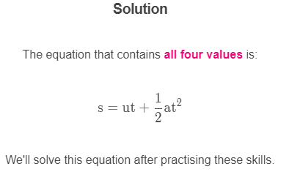

Slide 11
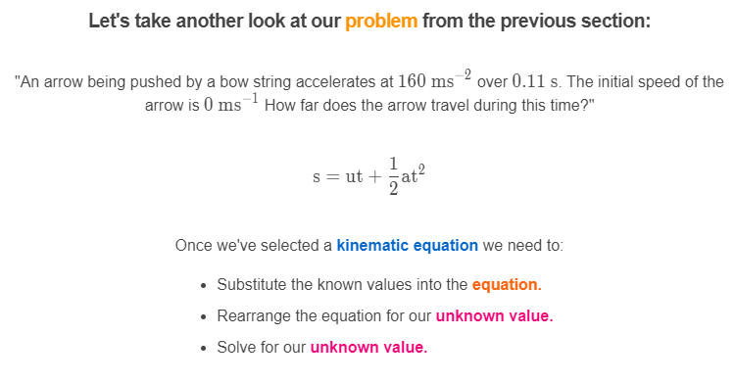

Slide 12
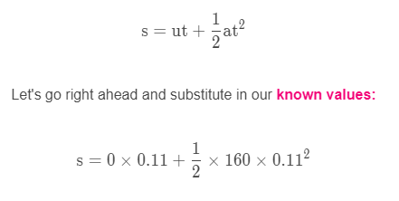
Once we have the equation, we need to substitute in the known values:
"An arrow being pushed by a bow string accelerates at 160 ms⁻² over 0.11 s. The initial speed of the arrow is 0 ms⁻¹ How far does the arrow travel during this time?"

Slide 13
